Slide 1
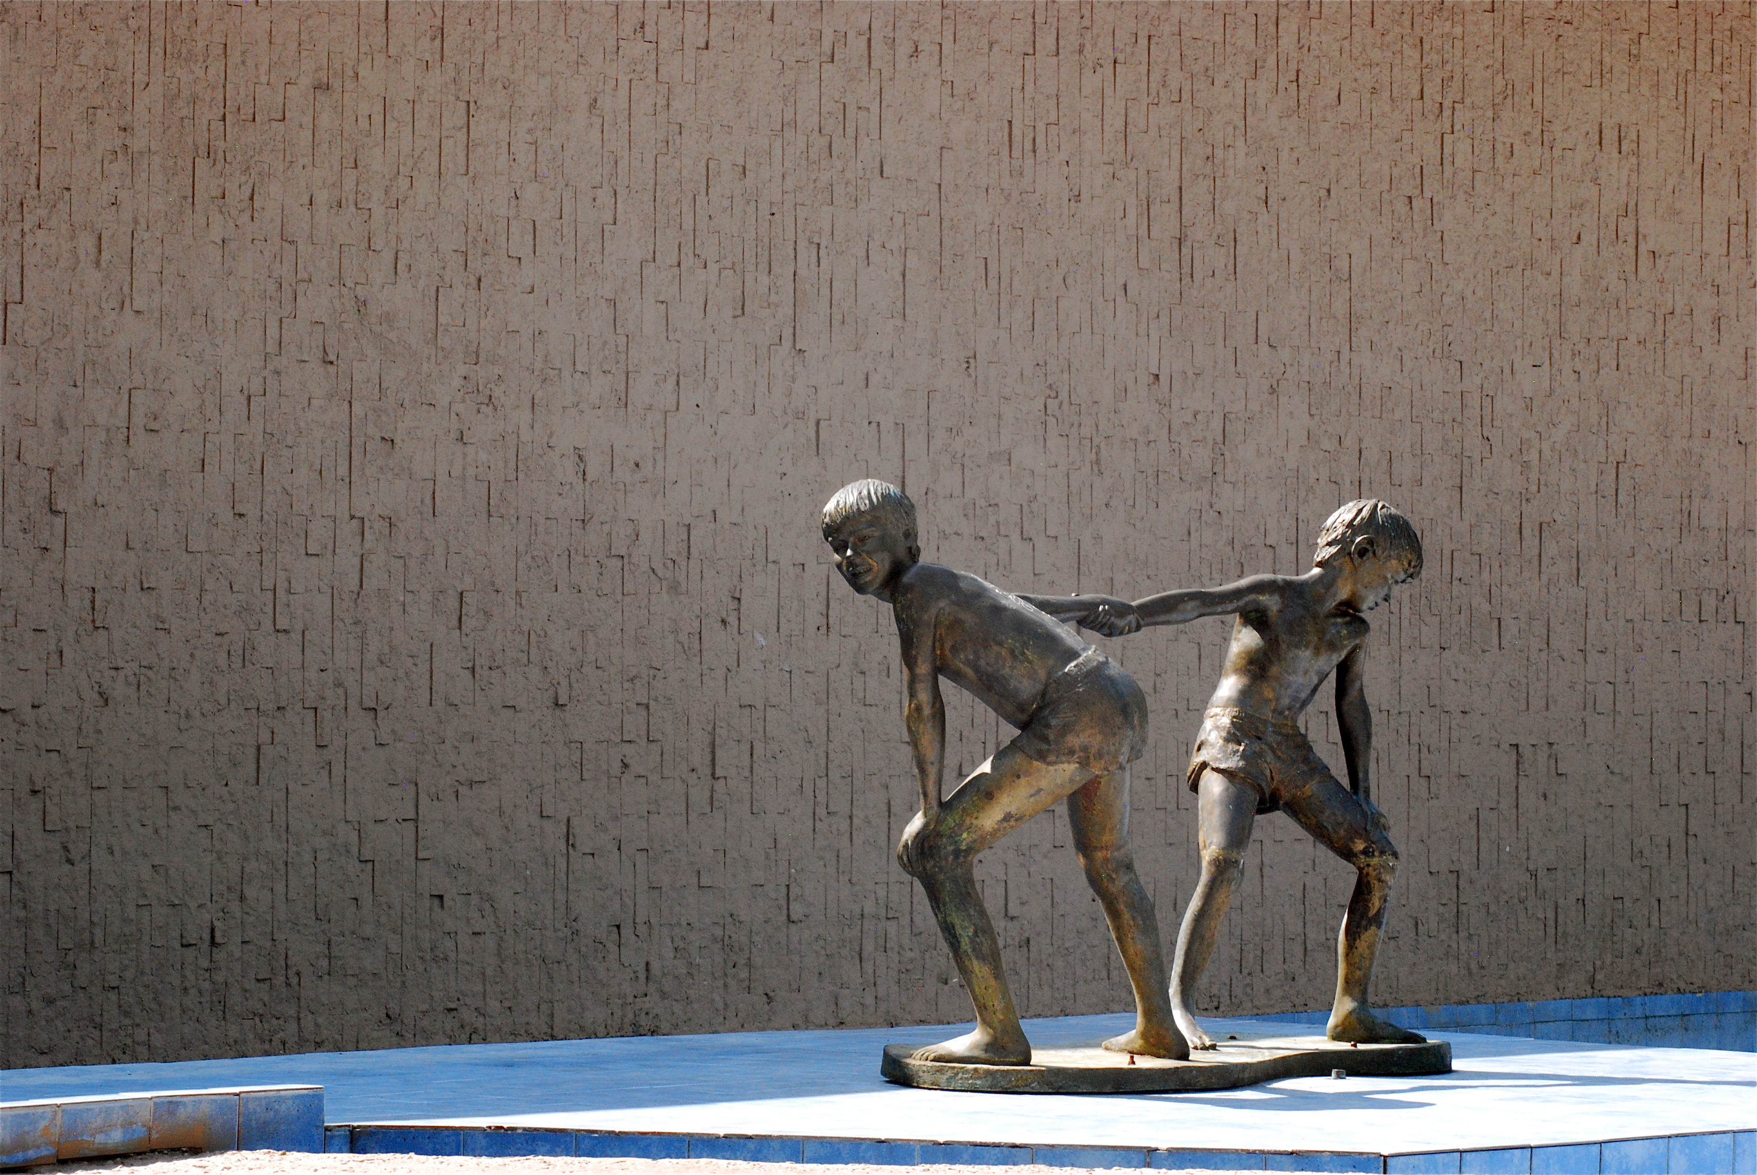
Dimensions of a Learning Network
Stephen Downes
National Research Council Canada
October 25, 2010

Slide 2
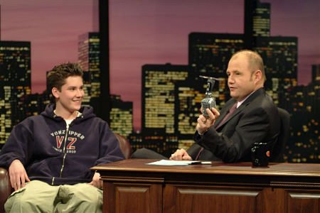
The humour is in the listener
Find something you have in common
Bring them around to your point of view
Make them laugh at themselves
Image: http://www.imdb.com/media/rm3822688768/tt0161180
http://halfanhour.blogspot.com/2010/09/uniqueness-and-conformity.html

Slide 3
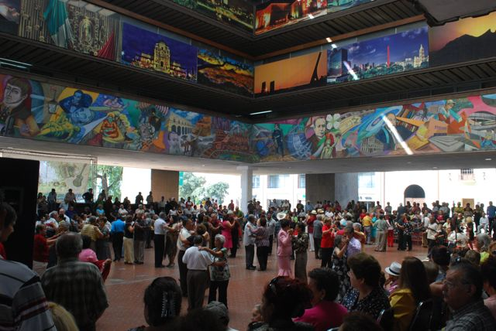
The dance is in the dancer
Common sense and a sense of humor are the same thing, moving at different speeds. A sense of humor is just common sense, dancing. ~William James
http://www.downes.ca/presentation/146

Slide 4
Learning Networks, or Networks that Learn
Today’s Topic
Conditions and constraints for success

Slide 5
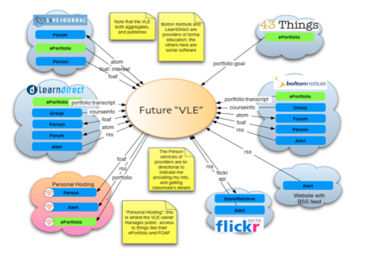
The Personal Learning Environment
Using networks to learn…
Image: http://www.cetis.ac.uk/members/ple/resources/edf.ppt
http://ple.elg.ca/

Slide 6
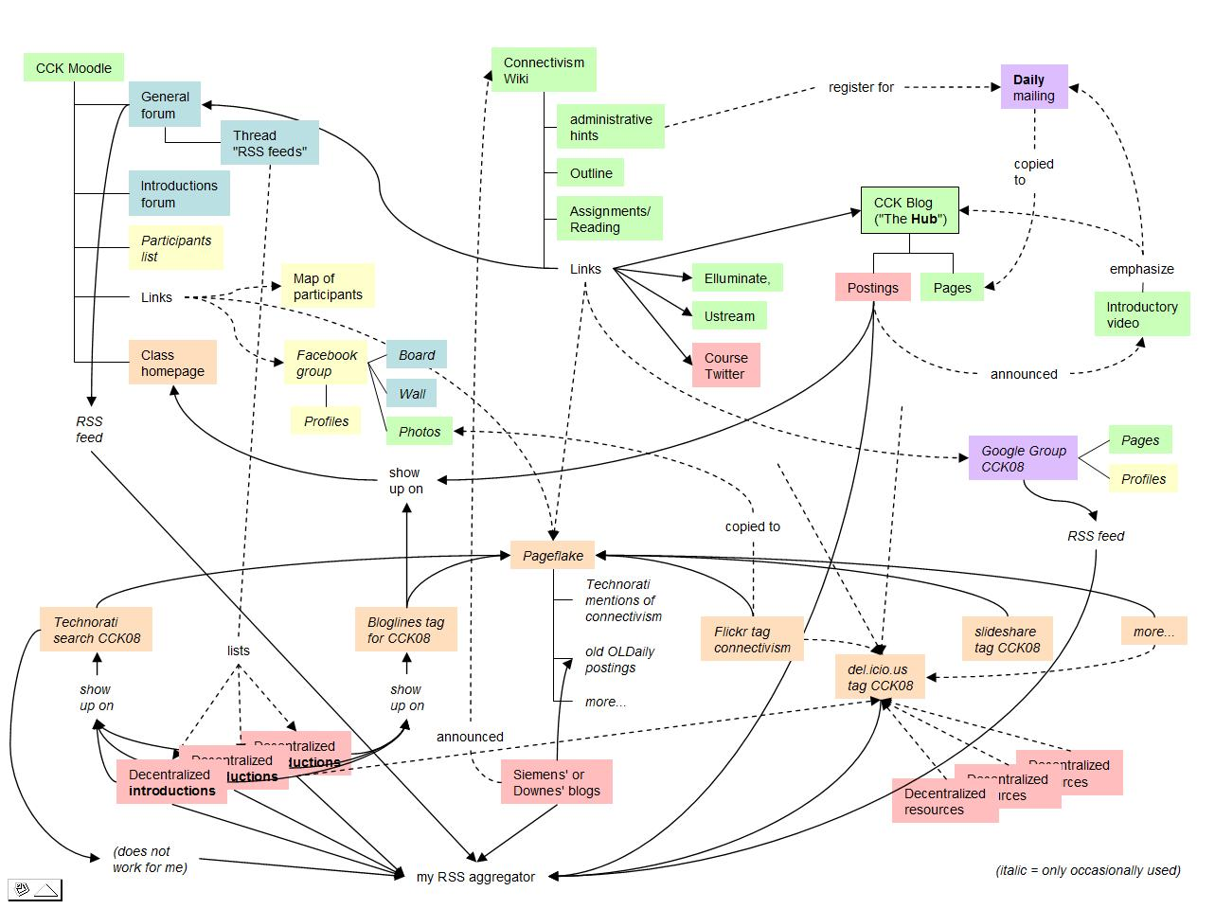
#PLENK2010
An instantiation of these constraints
A distributed learning environment
The MOOC
http://connect.downes.ca/

Slide 7
Yesterday
Attempting to understand using yesterday’s values…
Power, trust, incentive, propagation, broadcast, messaging
What we here are were surface phenomena

Slide 8
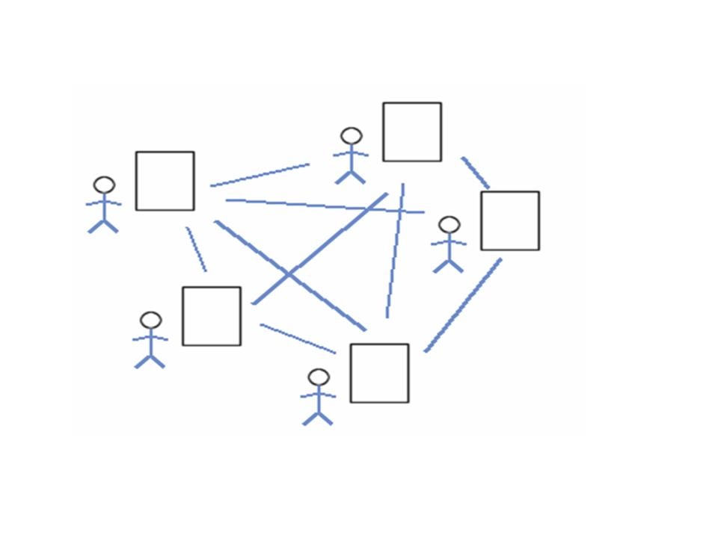
Collective Connective Intelligence
We are still in a world of mass, of masses of people, votes, ideas
These are the properties of the individual, applied to the whole
Is the power of the brain in the neuron?
Really?
http://www.downes.ca/post/43456

Slide 9
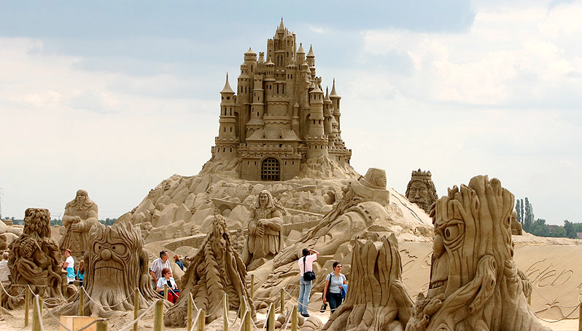
Organization
We’re trying to understand society by collecting individuals
But a sand castle isn’t just a pile of sand
Image: http://pixdaus.com/single.php?id=25529
http://www.downes.ca/presentation/257

Slide 10
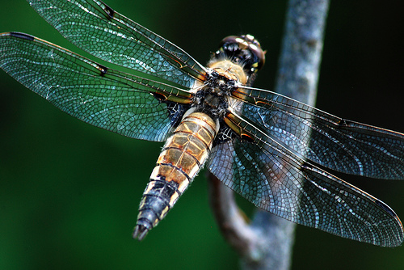
Connectivism
Knowledge is distributed across a network of connections
Learning is the ability to traverse and grow those networks
http://www.downes.ca/post/38653

Slide 11
Engagement and Empowerment
There is no curriculum, no body of knowledge - McGuffin
The product of learning is the learner
Fernando Flores
Emotional Fortitude
21st century skills
Image: http://www.masternewmedia.org/news/2008/06/01/making_sense_of_new_technologies.htm
http://www.downes.ca/post/51122

Slide 12
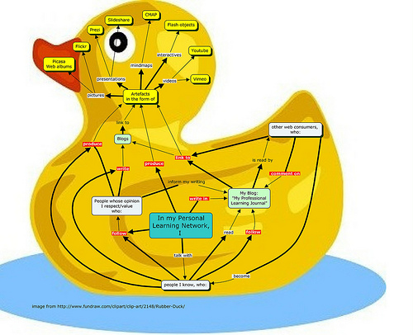
Connectivist Duckworks
Views from participants in PLENK2010
Image: http://www.flickr.com/photos/34318133@N03/5110104036/#/
http://enperfektlektion.blogspot.com/2010/10/would-i-pay-for-mooc-like-plenk2010_23.html

Slide 13
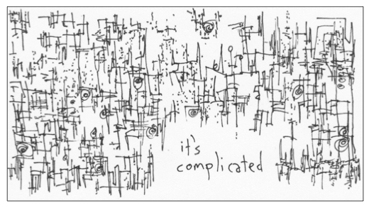
Complexity
It’s not that there’s nothing to learn
But that it’s complex, and needs to be navigated
Not memorized
Image: http://www.gapingvoid.com/complicated128.jpg
http://www.downes.ca/post/48669

Slide 14
gRSShopper
A tool for learning networks
It functions as a node
Not as part of a mass
http://grsshopper.downes.ca/

Slide 15
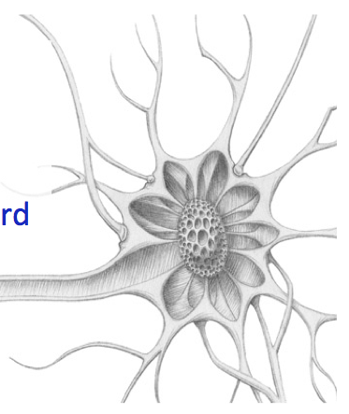
Learning is Immersive
We function as nodes in the network
Aggregate, remix, repurpose, feed forward
Craig Newmark: listen to people, repeat what they say, and then get out of the way.
http://ple.elg.ca/course/?p=18

Slide 16
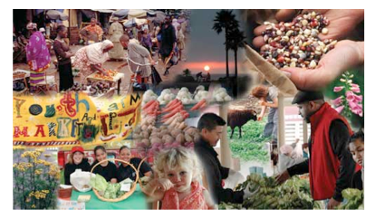
Learning is growth
We develop our neural net by participation in the social net
That is also how we develop the social net
http://www.downes.ca/post/53527

Slide 17
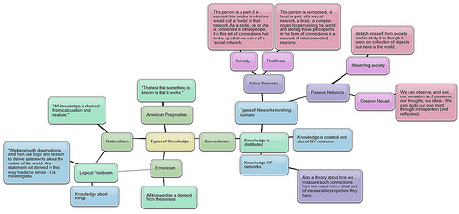
Networks, Network Theory
Two kinds of knowledge
– personal knowledge
– social, or public knowledge
Networks in general
A common set of principles
Image: http://techticker.net/2008/09/16/types-of-knowledge/
http://www.downes.ca/post/33034

Slide 18
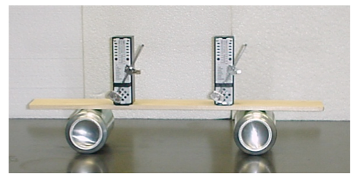
Metronomes
Self Organization
http://salt.uaa.alaska.edu/dept/metro.html
http://www.youtube.com/watch?v=W1TMZASCR‐I

Slide 19
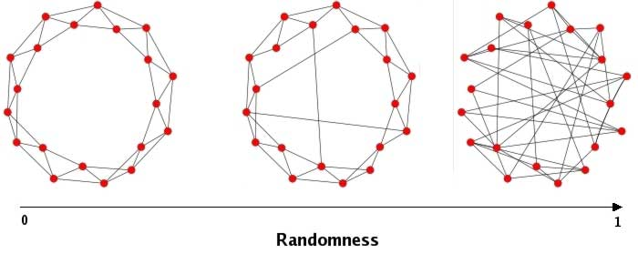
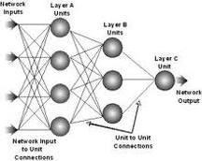
Graph Theory, Connectionism
Underlying Principles

Slide 20
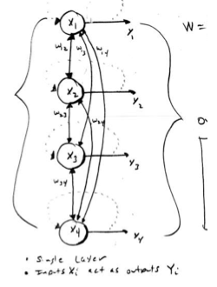
Principles of Association
How networks learn = how networks form connections
Similarity
Hebbian association
Proximity
Hume - contiguity
Feedback
Back Propagation
Harmony
Boltzmann Mechanism
http://www.downes.ca/post/53544

Slide 21
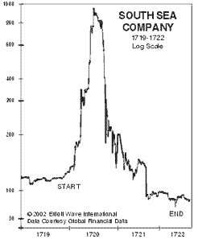
Cascade Phenomena
Quality of network learning =
Retained and expanded capacity to form connections
Cascade phenomena (diseases, propaganda) = network death
http://www.downes.ca/post/53882

Slide 22
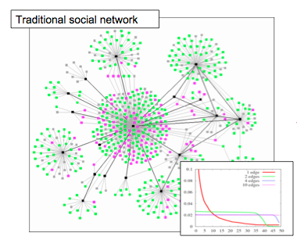
Network Structure - Tree
Centralized, based on influence, trust
Characterized by power law, viral propagation, hierarchy
http://middleburydemocrats.wordpress.com/2008/09/28/college‐democrats‐getting‐obama‐to‐go‐viral‐no‐really/

Slide 23
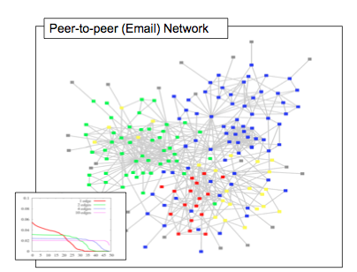
Network Structure - Mesh
Distributed, discussion based
Balanced, democratic
Stable
http://www.daniel‐lemire.com/fr/abstracts/DIVERSITY2008.html
blog/using‐email‐to‐uncover‐hidden‐social‐networks/

Slide 24
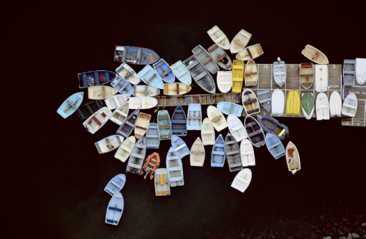
The Limits of Scale Free
When networks are not limited by physical constraints
They tend toward network death
Image: http://limitedfun.wordpress.com/category/photography/page/6/
http://www.downes.ca/post/48579

Slide 25
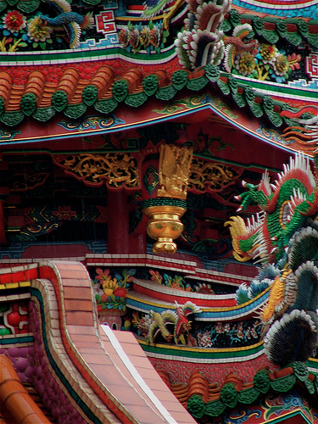
Stable (Self-Organizing) Networks
Decentralize
Distribute
Disintermediate
Disaggregate
Dis-integrate
Democratize
(The Semantic Principle)
Dynamize
Desegregate
http://www.downes.ca/presentation/32

Slide 26
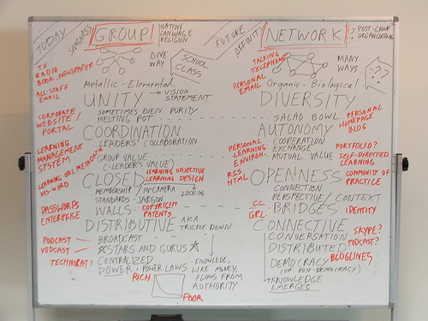
The Semantic Principle
Autonomy – individual values, not collective (or corporate) values
Diversity – each person has a distinct perspective
Openness – there are fluid boundaries, no ownership or walls
Interaction – the knowledge is the network, not in the individual
Fernando Flores
Pluralistic Networks
http://www.flickr.com/photos/stephen_downes/252157734/

Slide 27
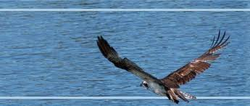
Impact
These values are not just abstract
They represent a shift in business values from ownership and control to stewardship, agility and stability
They should inform everything from management practices to software purchases
http://www.downes.ca/post/38502

Slide 28
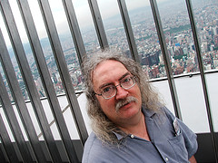
Stephen Downes
http://www.downes.ca

